Slide 1
SEIS 601 Final Project Notes Program
By: Pratiksh Patel

Slide 2
Team Members
Pratiksh Patel
Chintal Patel

Slide 3
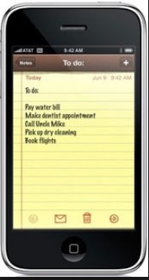
Rationale behind project selection
For our final project we decided to create a to do list because we both use the notes app on our smartphones.
Writing the Notes program made logical sense to us as the scope of the program would be more than just a final project for this class. It would be something that we would be able to use in our daily lives as well.

Slide 4
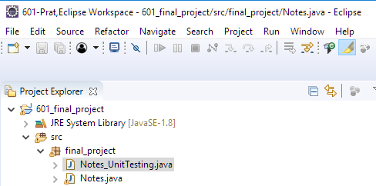
Eclipse IDE Software was utilized for the project
Software Used for writing unit tests
Name | Eclipse IDE for Java Developers
Version | Oxygen.1 Release (4.7.1)

Slide 5
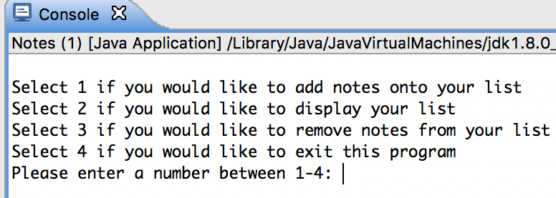

User Enters Inputs

Slide 6
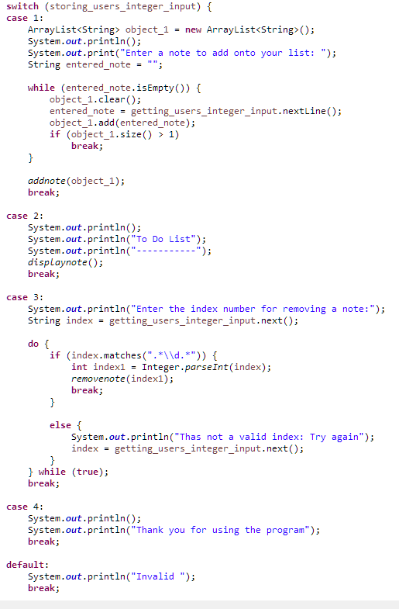
Case Statements used

Slide 7
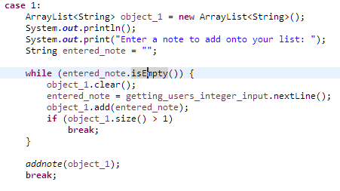

Selection 1 Adding notes Main method(Case 1) calls addnote method

Slide 8
Creating new Notes
First Note
After First

Slide 9
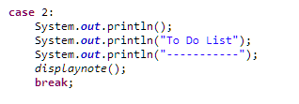
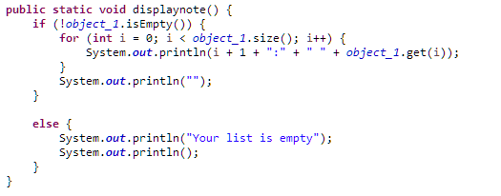
Selection 2 Main method(Case 2) calls the Display Note method

Slide 10
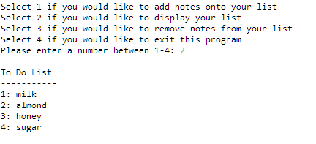
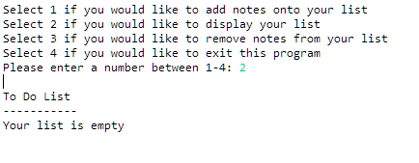
Displaying Notes

Slide 11
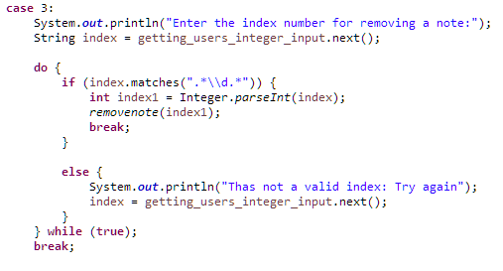
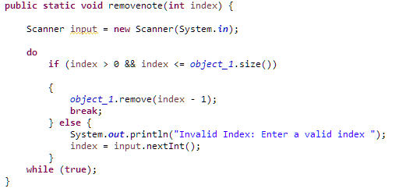
Selection 3 Main method(Case 3) calls the removenote method

Slide 12
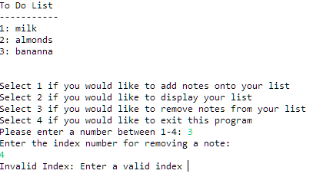
Handling invalid Index for removing a note

Slide 13

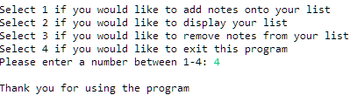
Selection 4 Main method (case 4) quits the program

Slide 14

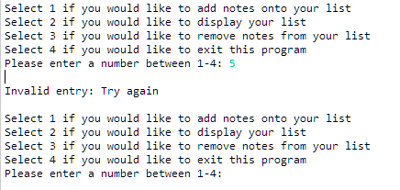
Default

